Slide 1
ELECTRONIC PROPERTIES OF MATTER
NAME OF THE INSTRUCTOR: U. NITHYA M.Sc.,M.Phil.,

Slide 2
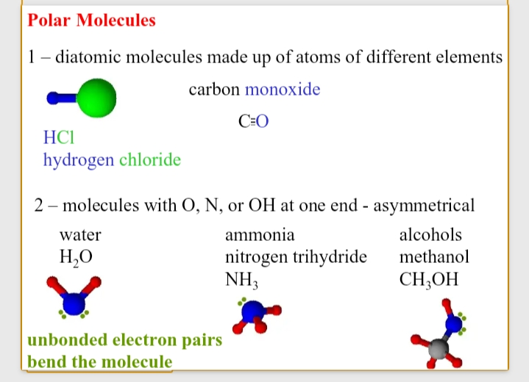
Polar and nonpolar molecules

Slide 3
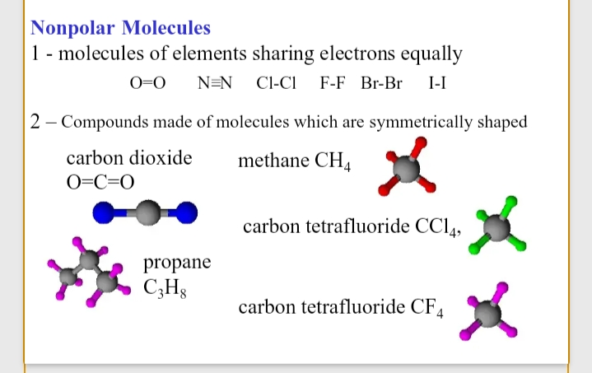

Slide 4
Polarisation of molecules:
when a molcule is placed in an electric field the field polarises it in the three following ways
orientation polarisation (P_{o})
Electron polarisation (P_{E})
Atom polarisation (P_{A})

Slide 5

Orientation polarisation (P_{o}):
The electric field tends to align those molecules which possess a permanent dipolement along the directionof the field. This is called orientation polarisation (P_{o})
Debye showed that. 2
4.
P_{o} = ------- π N [ ----- ]
3 3kT
μ

Slide 6
ELECTRON POLARISATION ( P_{E}):
Electron polarisation occurs because the field distorts the electronic cloud of a molecule.
n²- 1. M
P_{E} = ---------- ----- = [R]
n²+ 2. p

Slide 7
ATOMIC POLATISATION (P_{A}):
The field distorts the nuclei ( or the atoms) towards the negative end of the field. This is called atomic polarisation (P_{A}).
The value of P_{A}= 5 to 10 % of P_{E}

Slide 8
INDUCED POLARISATION(P_{I}):
A molecule with induced dipole moment is said to have induced polarisation or distortion or molar polarisation.
The induced polarisation is composed of two parts as follows
P_{I}= P_{E}+P_{A}

Slide 9
Total molar polarisation :
For any molecule the total molar polarisation (P) is equal to the sum of its orientation polarisation and snd its induced polarisation.
P= P_{O}+P_{I}
Debye derived the following equation
Mosotti and clausius related total molar polarisation
_{D - 1. M}
P = [----------] ------
D+ 2. p

Slide 10
Dipole Moment :
The degree of polarity of a molecule is expressed in terms of dipolemoment. It is defined as the product of the mangnitide of one of the charges and the distance between them.
μ = Z x d

Slide 11
Determination by
a. Temperature method
b. Refractivity method
C . Dilute solution method

Slide 12
APPLICATIONS OF DIPOLEMOMENT:
1.Shapes of molecules
2. Distinction between cis –trans isomers
3. Dipole moments of linkages
4. Bond angles
5. Presence of resonance
6. Caculation of molecular size
7. To estimate percentage ionic character/ The polarity of a molecule.

Slide 13
THANK YOU

